Slide 1

International Enterprise
Multi-Dimensional Project Management
SUMMARY
Charles Darwin: "It is not the strongest of the species that survives... nor the most intelligent - it is the one that is most adaptable to change"
Notes:
Cours de direction de projets internationaux appliqués à l’entreprise dans un monde connecté.

Slide 2

Course summary
WBS
OBS
RIW
PDR
GANTT
This star
indicates a key slide
PDW
SCOPE
Projects
Selection
Concept
Plan
Develop
Qualify
Deploy
Lifecycle
Communication Mgt
Contract Mgt
Cost Mgt
Planning / Schedule Mgt
Pb / Issue mgt
Scope / Change Mgt
Team Mgt
Documentation Mgt
Risk / Quality Mgt
Project Def Report - Project Def report – Work Breakdown Struct – Organizational Breakdown Struct – Risk identifcation Workshop –

Slide 3
Organizational construct for a Flexible E-Business
Marketplace
Corporate & Business Strategies
Business Transformation system
Business
Planning
Value chain definition
Initiative definition
Project / programme mgt
Operations
Mgt
Perf mgt
Requirement mgt
Problem mgt
Change mgt
Sunset mgt
Pre-concept
Concept
Plan
Develop / Qualify
Roll-out /Lifecycle
Governance
Process
& Standards
Business
Performance Mgt
Notes:
Le système de « Business transformation » (aide à la flexibilité de sprocessus
Fonctionnels au sein de la structure) est intégré à l’organisation.
Il permet d’adapater la structure en fonction des variations (marché, etc)

Slide 4
Implement a project-based, matrix organisation
Project 1
Project 2
Procurement
Marketing
Production
Finance
HR
Legal
Project 3
Overall projects / programme
coordination
Notes:
Voici une organisation bas ée sur des projets, dite « matricielle ».
Les directeurs de projet sont cross-fonctionnels.

Slide 5
All projects face a three-dimensional constraint : “the scope”
Cost
(high-level estimates)
Measurable
OBJECTIVE
Milestones
(High-level Planning)
Deliverables (main elements produced by the project)
Notes:
Un point essentiel : le triangle du projet. Temps-Cout-Fonction (scope = périmètre)
Proche d’un cahier des charges, il donne la vision globale du projet.

Slide 6
What are the phases of a project ?
1- Projects
Selection
5
Qualify
6
Deploy
7- Projects
Lifecycle
2 - Concept
4
Develop
3 - Plan
Projects development
Notes:
Quelles sont les phases d’un projet ?
Ces phases sont toujours les mêms, quelque soit le ^projet.

Slide 7
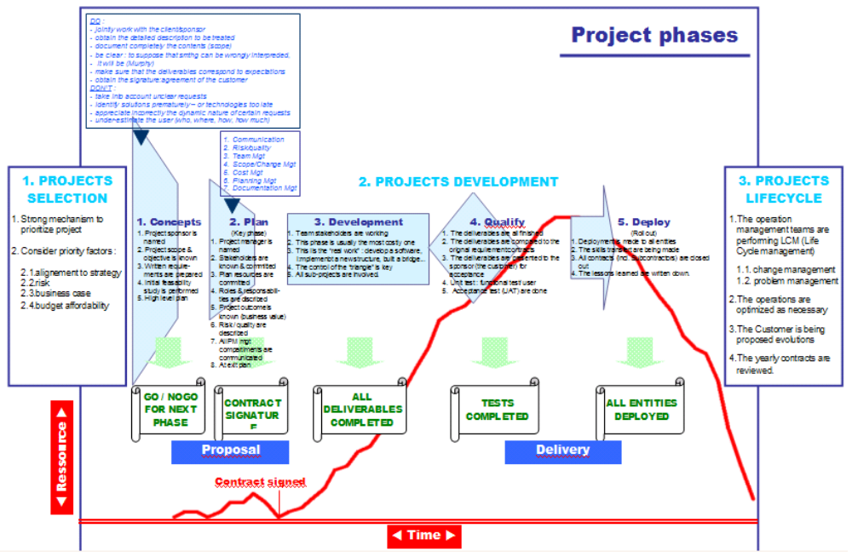
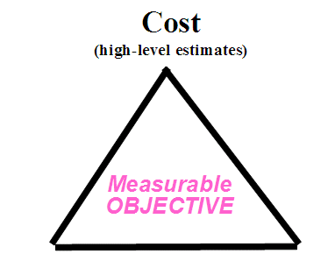
A summarized view of Project phases
7
2
3
4
5
6
Notes:
Vue résumée : les pahses et la courbe d’effort.

Slide 8
What are the key documents and meetings in a project ?
Kick-Off
meeting
PDW
Steering
Committee
meetings
Kick-Out
meeting
Core Team
Meetings
RIW
Qualify
Deploy
Concept
Plan
Develop
PCB
PDR
Project
Charter
Team
Charter
PDW Project Definition Workshop
RIW Risk Identification Workshop
PDR Project DefinitionReport
PCB Project Control Book
Notes:
Ce graphique reprend les éléments essentiels en termes de réunions et de documentation

Slide 9
TLAs(*) list
PDW Project Definition Workshop
WBS Work Breakdown Structure
OBS Organizational Breakdown Structure
PDR Project Definition Report (50 pages)
PCB Project Control Book (2000 documents)
RIW Risk Identification Workshop
KPI Key Performance Indicator
* Three-Letters acronyms

Slide 10
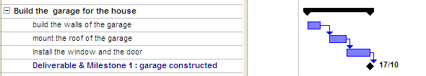
Milestones and Deliverables
Each milestone corresponds to a deliverable
Each summary task should be ended by a deliverable and a milestone
Milestones are used to provide high-level view of the plan
Deliverables are visible on the contract
A milestone is a zero-duration, zero-cost task

Slide 11
Risk drivers
Intrinsic : Caused by the nature of the project and the circumstances (eg New technology)
Imposed : Ts and Cs can make objectives unachievable (eg Performance)
Induced : Introduced by bad planning or bad control (eg requirements badly defined)
External : Introduced by factors outside the project management (eg weather, social)
T’s and C’s : Terms and Conditions
Notes:
Ces 4 facteurs de risque coexistent : de l’intérieur, de l’extérieur, imposés ou induits.

Slide 12
Standard for task representation
(CPM-Critical Path Method)
Early Start
Early Finish
Task
Duration
Late Start
Late Finish
Note : other methods are :
PERT method is based on probabilities: Average duration is (o + 4m + p)/6
GERT and CDM (conditional diagraming method) allow loops and dependancies
Notes:
Voici le modèle de reporésentation de la méthode CPM (méthode du chemin critique)
ES : date de fin au plus tot, EF : date de fin au plus tôt
LS : date de début au plus tard, LF : date de fin au plus tard.

Slide 13
How to manage the risks in a projects ?
Run a Brainstorming session (RIW, Risk Identification Workshop) with proposal team, sponsor, technical gurus : Quantify / Assess Impact & Probability for each risk, using team specialists judgment, or checklists, or expert tool,
Position the risks on a prioritisation matrix,
Evaluate the cost of their action plans (contingency + mitigation) and decide on a risk response for each one,
Evaluate the consequent cost increase on the project, get formal approval,
Implement the risk actions within the WBS
Organise monthly risk reviews and update the plan as necessary.
RIW + regular (monthly?) reviews
RIW
Notes:
Méthode pour identifier et gérer les risques : une session d’identification µ+ des revues régulières.

Slide 14
Step 1 – Identify the risks, evaluate probability & impact
before
after
Risk driver -(EXT, IND, INT, IMP) | Which Impact on project ? | Probability Level | Proposed Contingency action * (reduce probability for the risk ho tappen) | Impact Level | Proposed Mitigation action* (reduce impact after the risk happened) | Risk Owner
It may rain (EXT) | People are wet & can’t work | L | N/A | L | Use raincoats | Joe
Resources may not be available (EXT) | Supply chain may be stopped | H | Outsource supply chain | H | N/A | Mark
There is a new technology involved (INT) | Project may be in jeopardy | H | Use few new technology | M | Train people on new technology | Ralf
Quality may not be at the right level (IND) | Deliverables may be poor | M | Implement ISO 9000 | H | Implement ISO 9000 | Stella
Volumes could be greater than expected (EXT) | Customer may lack products | M | N/A (this is a positive risk) | H | Add a clause to transportaiton contract for flexibility | Guillaume
* Lat. Contingentia – chance Mitigare – smoothen
Notes:
Cette matrice est essentielle et permet de contrôler chaque risque.
Il s’agit de préventif et de curatif.

Slide 15
Step 2 – Position the risks in a prioritisation matrix
Low Occurrence >> High
Resources may not be available
There is a new technology involved
Quality may not be at the right level
Volumes could be greater than expected
Low Impact >> High
Attack those risks first
It may rain
Notes:
Cette matrice est utilisée pour prioriser les risques.

Slide 16
Step 3 – Estimate the cost of the decided action plans
Risk driver | Which Impact on project ? | Probability Level | Impact Level | Proposed Contingency action * (reduce probability before the risk happens) | Proposed Mitigation action* (reduce impact after the risk happened) | Decision | Cost of the risk action plan
It may rain | People are wet & can’t work | L | L | N/A | Use raincoats | Ignore risk | 0 $
Resources may not be available | Supply chain may be stopped | H | H | Outsource supply chain | N/A | Transfer risk to another organization | 5 K$
There is a new technology involved | Project may be in jeopardy | H | M | Use few new technology | Train people on new technology | Establish Contingency only (no mitigation) | 15 K$
Quality may not be at the right level | Deliverables may be poor | M | H | Implement ISO 9000 | Implement ISO 9000 | « Contain » risk Contingency + mitigation) | 200 K$
Volumes could be greater than planned | Customer may lack products | M | H | N/A (this is a positive risk) | Add a clause to transportaiton contract for flexibility | Establish Mitigation | 4 K$
* Lat. Contingentia – chance Mitigare – smoothen
Notes:
Cette matrice est essentielle et permet de contrôler chaque risque.
Il s’agit de préventif et de curatif.

Slide 17
Critical Path
3
9
9
18
6
9
3
9
9
18
1
3
9
11
2
5
2
11
16
18
21
3
1
11
13
18
21
3
13
18
3
15
12
6
18
Critical path is where EF=LF (or ES=LS)
They are the tasks to concentrate on.
Notes:
On voit le chemin critique, qui est fait de l’ensemble des tâches critiques
(celles ou les chiffres du haut sont identiques à ceux du bas).

Slide 18
PM Softwares vs. Project Size & Complexity
# WBS lines
10000
Create subprojects
Corporate tools
RPM, ESE, PMP, PMO,
1000
Open Project (*)
MS Project
100
spreadsheets
Use Communication tools
Web site, Notes, etc.
10
1
10
100
1000
# stakeholders
(*) Other products : M/S Project Primavera; PSN, Open plan, Augeo, Superproject, Gantt project…
Notes:
A chaque taille d eprojet correspond son logiciel.

Slide 19
MBTI* theory : overview
E / I S / N T / F J / P
Energy
inside/outside
Information
Processing &
Decision making
Information
Implementation
Information
perception
In France, Meyers-Brigg Type Indicator theory is a registered mark of the OPP Company
Notes:
Ces graphiques reprennent ces éléments.
Nota les lettres en anglais rajoutent un élément de complexité.

Slide 20
The Coach…
The four levels of management
Participative
Persuasive
Dissuasive
Directive
motivates the team
listens to individuals
Coaching at reebok video
The Leader…
inspires a vision / a future
innovates and takes risks
federates the team: motivates and animates
Negotiates: to influence a decision
Inspires confidence (with the int & ext.)
Asks "why"
Leads
The Manager…
Manages the short term
builds
administrates
obtains concrete results in line with expectations
asks "how" and "when“
controls
Les gendarmes video
Steve ballmer video
Notes:
Chacun des roles est necessaire. Il faut les connaître et savoir les appliquer en fonction
De la situation.

